Slide 1

DR MARIJN NIEUWENHUIS (marijn.d.nieuwenhuis@durham.ac.uk)
ASSISTANT PROFESSOR HUMAN GEOGRAPHY AND WIDENING PARTICIPATION OFFICER

Slide 2
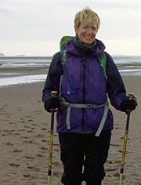
About
2nd nationally (2021 Times / Sunday Times Good University Guide); 12th globally (2021 QS World University ranking)
World-leading research and teaching by almost 70 members of academic staff, 13 tech staff, 14 admin support, and close to 100 postgraduate researchers
Head of Department: Professor Cheryl McEwan
Excellent students: annually dissertation winners (from “A Sedimentological Reconstruction of the Glacial History of Happisburgh” to “Investigating the effects of mobile dating apps on love and intimacy and identity negotiations for bisexual individuals”)
Support network for first-generation scholars; Development of practices for decolonising the curriculum at the module level and EDI committee
Two UG courses: BA and BSC (with many integrated options)
Professor Cheryl McEwan

Slide 3
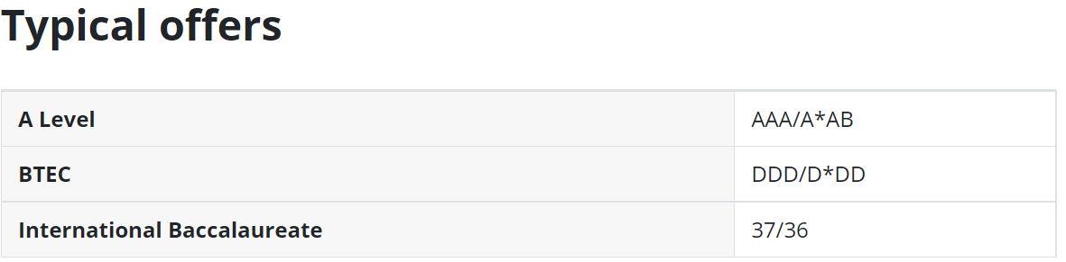
BSc Geography - F800
Year 1:
Compulsory : Physical Geography; Introduction to Climate Change, Introduction to Geographical Research (BSc) – double module including overseas residential fieldwork and Human Geography.
Optional (two): Geographies of Crisis, Understanding Earth’s Principles and others
Year 2:
Compulsory : Scientific Research in Geography, Handling Geographic Information
Optional (three): Climate Change: Geographical Perspectives, Glaciers and Glaciation, Mountain Landscapes and others, and option to choose a module from the BA track
Year 3:
Dissertation
Optional (worth 80 credits): The Arctic (Norway field trip); Alpine Landscapes and Processes (Switzerland field trip); Mountain Hazards (Nepal field trip) and others, including BA option.
Placement possibilities (between second and third year) and Study abroad opportunities (Singapore, Hong Kong Melbourne and others) between second and third year.
More info: https://www.durham.ac.uk/study/courses/f800/

Slide 4
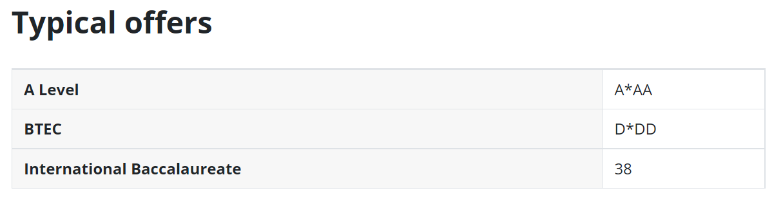
BA Geography - L702
Year 1:
  Compulsory : Human Geography, Introduction to Climate Change, Introduction to Geographical Research (BA), Physical Geography.
  Optional (two): Geographies of Crisis, Understanding Earth’s Principles and others
Year 2:
  Compulsory : Social Research in Geography (includes compulsory residential fieldwork in the UK), Theory and Concepts in Contemporary Human Geography.
  Optional (three): Economic Geography, Urban Geography etc., integrated modules and option to choose from the BSc track
Year 3:
  Dissertation
  Optional (worth 80 credits): Berlin: Culture, Politics and Contestation, Cape Town: Geographies of Energy Transition, Philosophy and Geography and others, including BSc option.
Same placement possibilities and Study abroad opportunities as BSc track.
More info: https://www.durham.ac.uk/study/courses/l702/

Slide 5
Summer schools
(reduced entry requirements for guaranteed offer)
Supported Progression: 14 January deadline, https://www.durham.ac.uk/visit-us/schools/access-engagement/supported-progression/
Sutton Trust: , https://www.durham.ac.uk/visit-us/schools/access-engagement/sutton-trust/
Space to Explore Potential (STEP): https://www.durham.ac.uk/visit-us/schools/access-engagement/step/

