Slide 1
Online MBA Careers Support

Slide 2
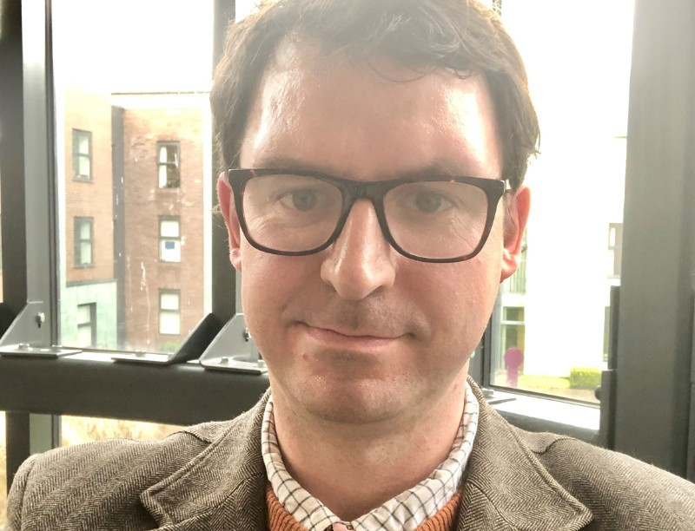
Tim McCollum
Qualified Careers Adviser
Worked in sector for 15 years
Exec Ed
Supported a lot of students into consultancy

Slide 3
Careers support- 121 coaching
Able to book in appointments
Individualised approach based on your needs
In depth careers support
Understanding Labour market and opportunities in specific global locations
Helps you to reflect upon your career journey and identify goals

Slide 4
Careers support- 121 coaching
To book an appointment email
charlotte.howell@durham.ac.uk

Slide 5
What can we help you to achieve?
Identify and understand your unique strengths and skillset
Develop necessary soft skills to compete in a global marketplace
Prepare for transitions into new countries, sectors, roles
Understand LMI and how this may inform your job search

Slide 6
Group Workshops
Alongside 1-2-1 support you will get the chance to attend careers workshops throughout the year
Designed to appeal to broad range of interests
Help you to advance in your career and understand the steps you may need to take
Will be advertised and promoted to give you a chance to attend

Slide 7
Alumni Support
Continue to benefit from Careers Support after graduation
Attend chapter events globally
Over 30,000 DUBS Alumni
Networking events
This Photo by Unknown Author is licensed under CC BY-ND

Slide 8
Your key conatcts
OMBA Careers Consultant,
Tim McCollum
tim.mccollum@durham.ac.uk
Careers coordinator:
charlotte.howell@durham.ac.uk

