Slide 1
Introduction to CPD- Career and Professional Development

Slide 2
Aims
OVERVIEW of team
CPD module and career support
STRATEGIC CONSULTING projects
Prepare for your mba
Questions

Slide 3

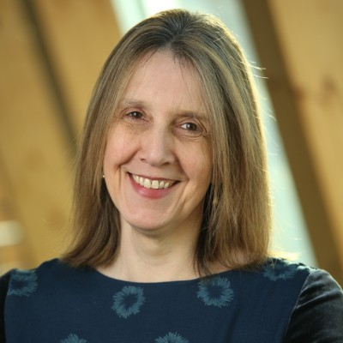
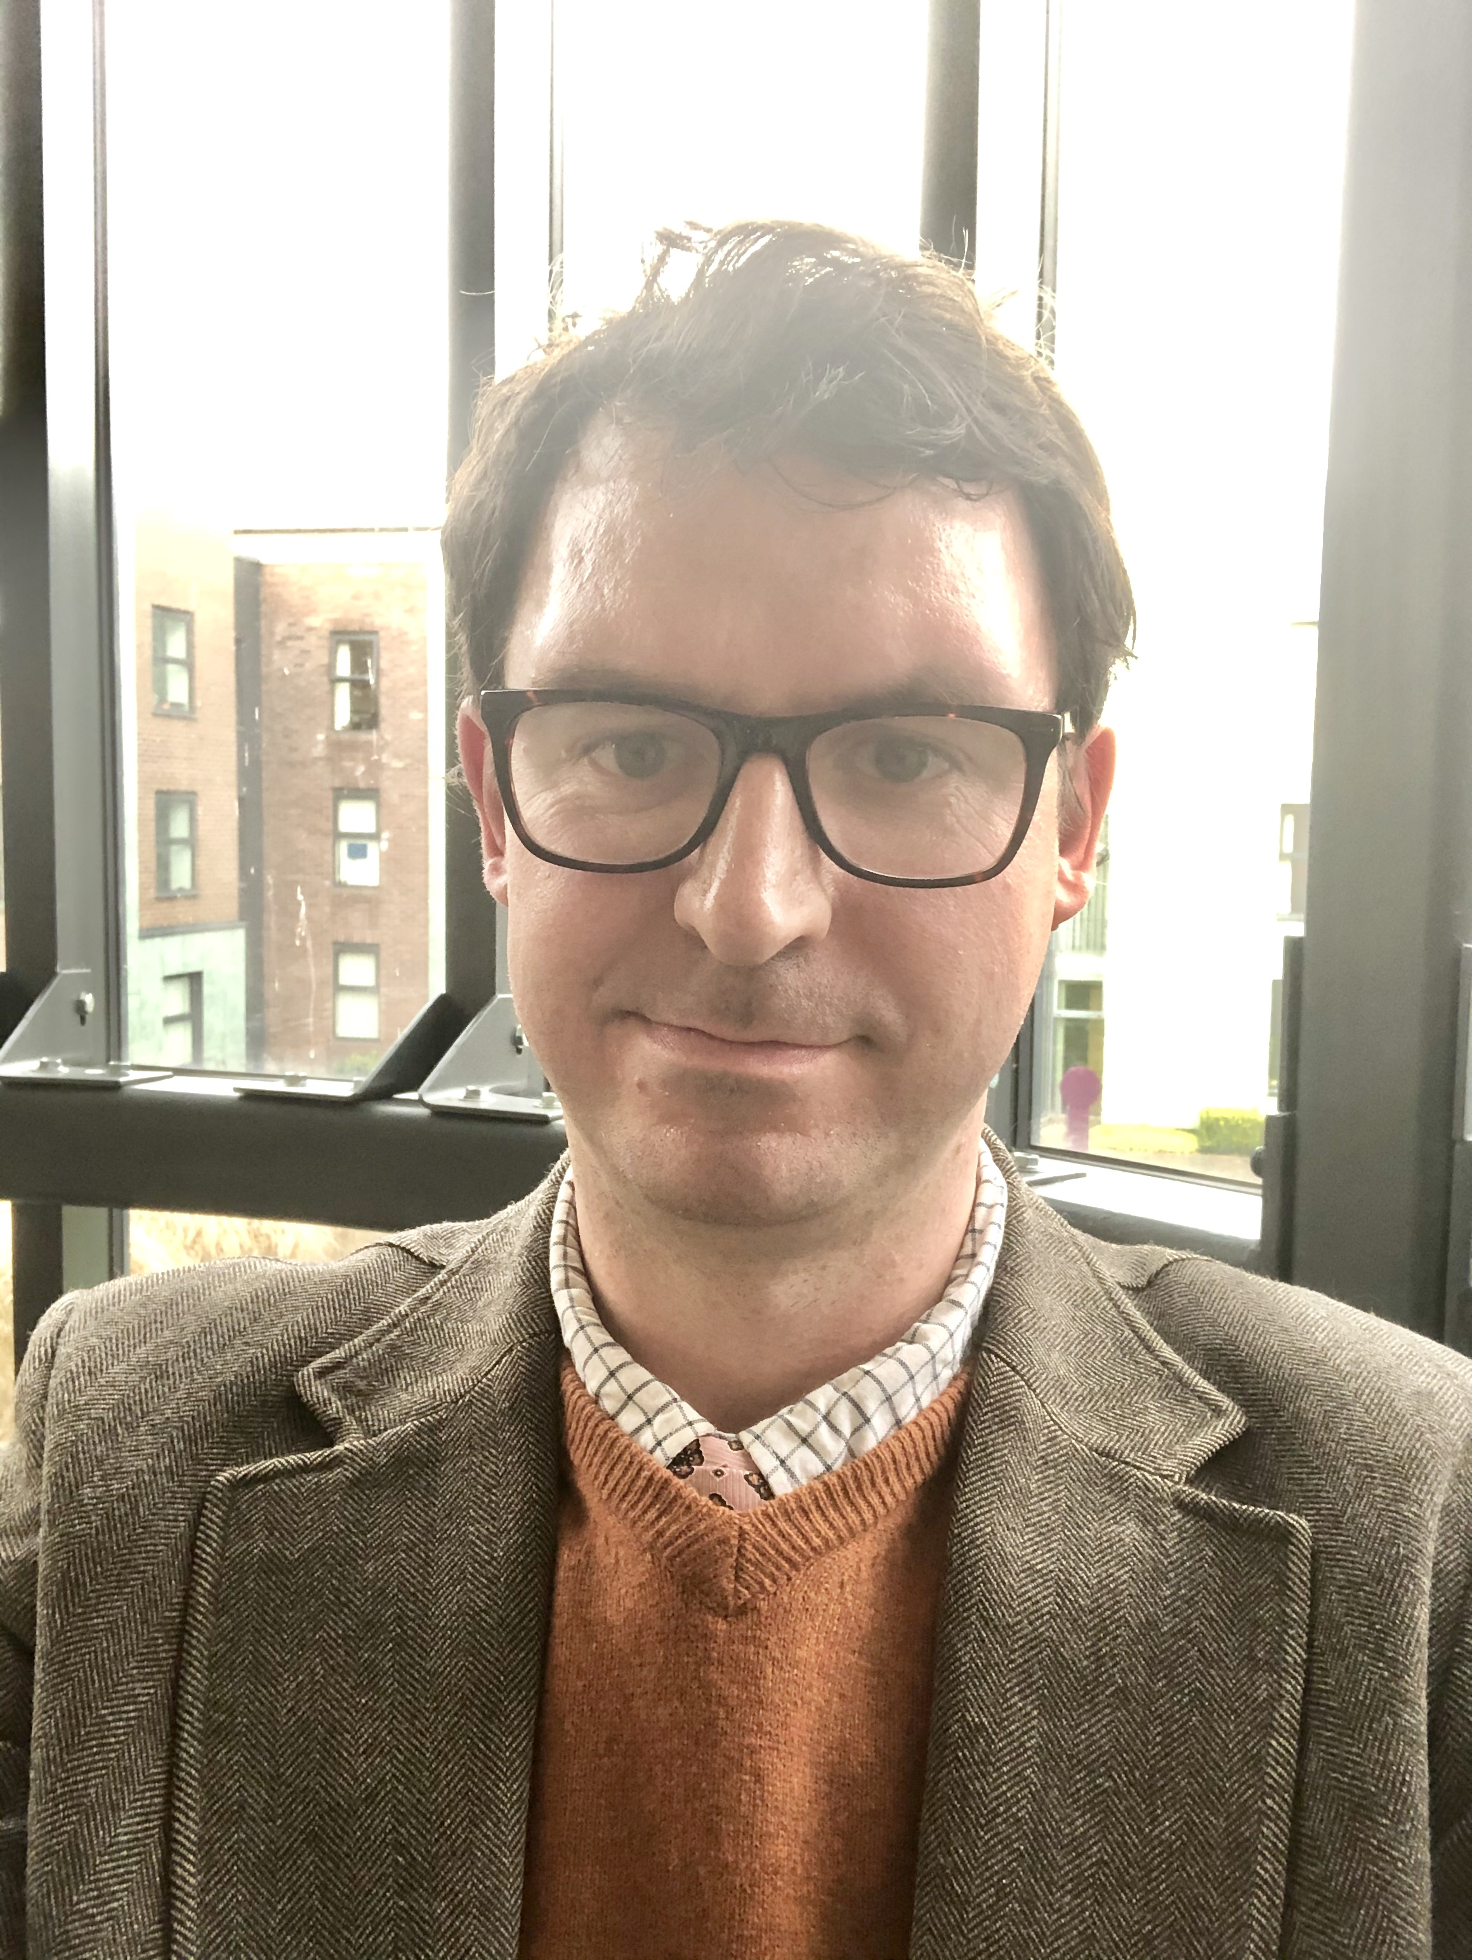
Introduction- Your MBA Team
Oliver Ruether Charlotte Howell Tim McCollum
Engagement Manager IEC Coordinator Careers Consultant

Slide 4
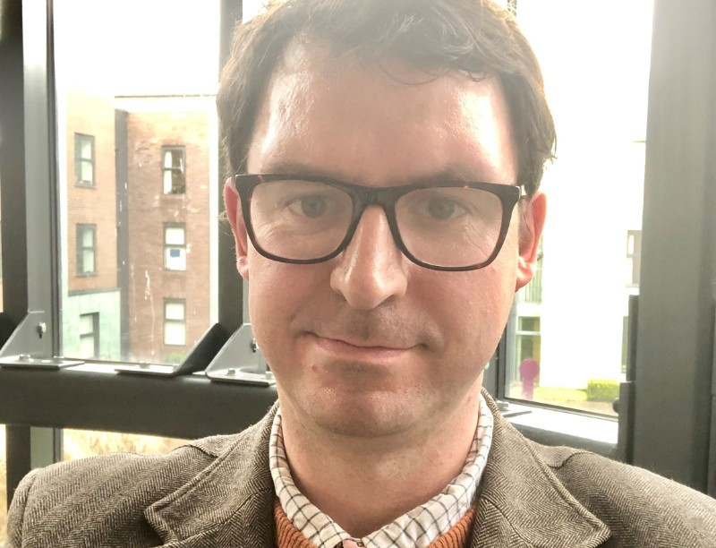
Tim McCollum
Qualified Careers Adviser
Worked in sector for 15 years
Worked at Durham for 4 years specialise with MBA/OMBA
Passion for skills development, mindset and how this influences our experience and success at work
Exec Ed

Slide 5
CPD Module- Competencies
Leadership
Self Awareness
Working in Groups and Teams
Communicating through networking
Career advancement
Communicating through presentation
Planning, organising and time management
Negotiation and influencing
Digital
Working collaboratively
Visualising Data
Analysing Data
Making decisions
Managing projects
Accessing career opportunities
Contextualising your career development
Business Scenarios to allow you to build skills
Group discussion and self-reflection
Gives you the opportunity to develop and practice your skills
Meet different employers
Ethics and Sustainability
Identifying Values
Identifying ethical belief
Working with others with differing values and beliefs
Global
Communicating across cultures
Demonstrating sensitivity to diversity
Challenging own and other people’s preconceptions
Working effectively with people from diverse backgrounds
Working in an international context

Slide 6

Careers support
Individual 1-2-1 coaching appointments
Career planning and discussions
CV, Applications and Interviews
Networking and LinkedIn
Guest speakers and employer sessions
Workshops/Presentations
LMI and employer knowledge

Slide 7

CPD Workshops- Developing soft skills through workshops
Understand the specific skills you can offer
Focus on developing key soft skills to compete in global marketplace
Communicating
Presentations
Teamwork
Networking

Slide 8

Employer led sessions
Employer presentations
Recruiters
Company visits
London Events
Networking fairs
Alumni events and activities
Events with other schools
This Photo by Unknown Author is licensed under CC BY-NC

Slide 9
Employer led sessions
EY
Capco
Amazon
Ocado
Accenture
Sage
Google
OC and C Strategy
Tata Consultancy
UBS
Capgemini
Roche Diagnostics
This Photo by Unknown Author is licensed under CC BY-NC

Slide 10

Developing hard skills
Tableau
SCRUM
Excel
This Photo by Unknown Author is licensed under CC BY-SA

Slide 11
Careers support- Digital Platforms
Career Set
Dedicated careers platform with CV 360, Interview 360, E-learning
MBA Exchange
Jobs platform specifically for MBA students

Slide 13

Strategic Consulting Projects
Opportunity to work with employers on a consulting project
Projects can be sourced for you or you can find your own
Linked to your chosen pathway
Support from supervisor
Allows you to build skills further and demonstrate your progress

Slide 14

Before your MBA
Consider and reflect on your own career goals
Reflect on what you hope to get out of your MBA
Assess your own strengths/weaknesses
Identify skills you need to develop to achieve your goals
Update your CV, LinkedIn

Slide 15

After your MBA
Labour Market Intelligence
Effectively communicate your value
Confidence in your personal brand and skillset
Maintain your working mindset
Durham Alumni

Slide 16
Support with your next steps and career post MBA
Dedicated support from Engagement Manager
Help to develop your network through our alumni service and establish links with employers
Ongoing support after finishing your MBA
Guidance around your next steps, post MBA options and managing your career in a time of change

Slide 17

Q and A
?
86th in
the world
^{Financial Times}
^{Global MBA Ranking 2025}

Slide 18
Thank you for your time.
Email tim.mccollum@durham.ac.uk
https://www.linkedin.com/in/tim-mccollum-537450186/

